Slide 1

WeConnect Social Media Web Application
SUBMITTED
FOR
DIPLOMA IN ADVANCED COMPUTING FROM
CDAC HYDRABAD
PRENSENTED BY:
230350320100 – Shital Satpute
230350320099 – Saransh Singh
230350320094 – Sandeep Upadhyay
230350320091 – Rutuja Sawant
230350320098 – Sarang Topale 230350320090 – Rutuja Khawashi

Slide 2
TABLE OF CONTENTS
01
04
Introduction
Our Goals
02
05
Current Features
Project Stages
03
06
Major Requirements
Future Scope
Here you could describe
the topic of the section
Welcome to “WeConnect”
Enhancing Digital Connectivity,
Revolutionizing Social Media,
User Centric Technology
Post Creation , Like , Comments ,Dark and Light Modes , Responsive Webapp
Step 1 to Step 6
Hardware , Software and Other Requirements
Friend Search , Chat Retention , Update Profile Picture and Posts

Slide 3
INTRODUCTION
Connecting, Sharing, and Building Communities
MERN Stack
Digital Hub
Chat Forum
Revolutionizing Social Media
Power of Tech and Human Connection

Slide 4
—WeConnect
“Welcome to WeConnect, Connecting minds and fostering growth!”

Slide 5
CURRENT FEATURES
POST CREATION
ADD FRIENDS
LIKE AND COMMENT ON POST
d
RESPONSIVE WEBAPP
d
LIGHT/DARK MODE

Slide 6
MAJOR REQUIREMENTS
OTHER REQUIREMENTS
HARDWARE
SOFTWARE

Slide 7
HARDWARE
A computer with at least 8GB of RAM and a capable processor, such as Intel Core
i5 or higher, to ensure smooth system performance.

Slide 8
SOFTWARE
BACKEND Node.js and express.js
FRONTEND React JS and Redux
DATABASE Mongoose for managing MongoDB Database

Slide 9
OTHER REQUIREMENTS
Integrated Development Environment – VS-Code
Command Line Interface
A Browser

Slide 10
OUR GOALS
User-Centric Technology
Revolutionizing Social Media
Enhancing Digital Connectivity
Empower users to easily register, create profiles, and personalize their experience with light and dark mode options.
Enable individuals to share their stories and experiences on a global platform.
Enable individuals to share their stories and experiences on a global platform.

Slide 11
PROJECT STAGES
STEP 4
STEP 1
STEP 6
STEP 3
Backend Development
Frontend Development
STEP 5
STEP 2
User Authentication and Security, Other Features and Functionalities
System Design and Architecture
Project Planning and Conceptualization
Documentation

Slide 12
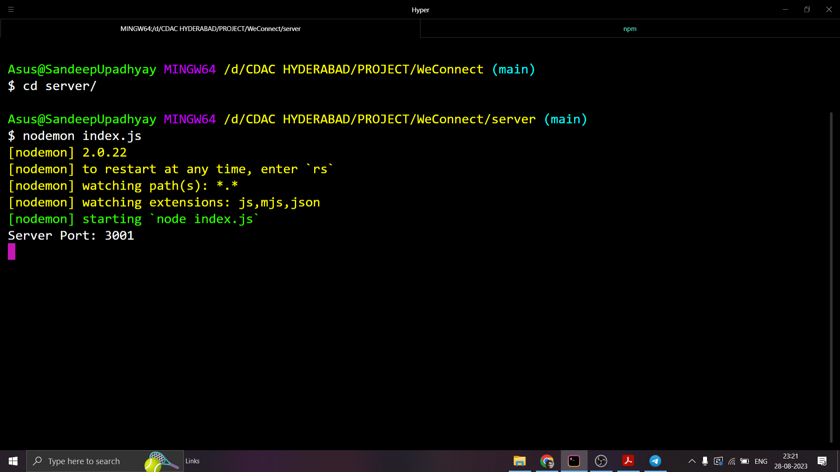
Steps to Run the Project
Server : In the server folder , Run “nodemon index.js”

Slide 13
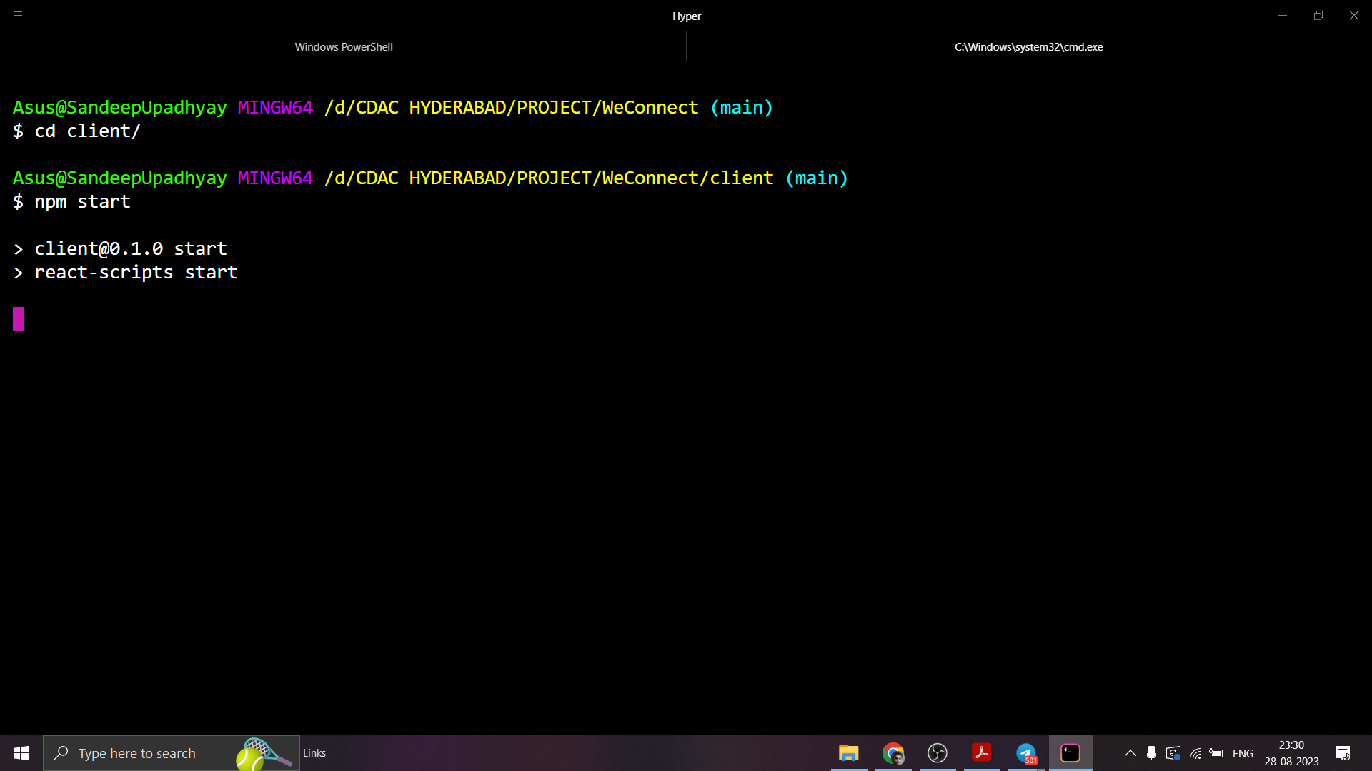
Client : In the Client Folder , Run “npm start”

Slide 14
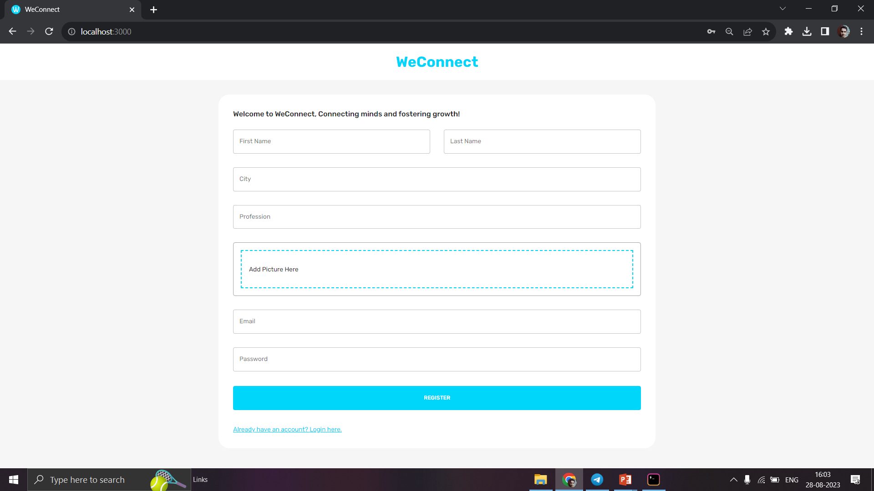
User Registration Page :

Slide 15
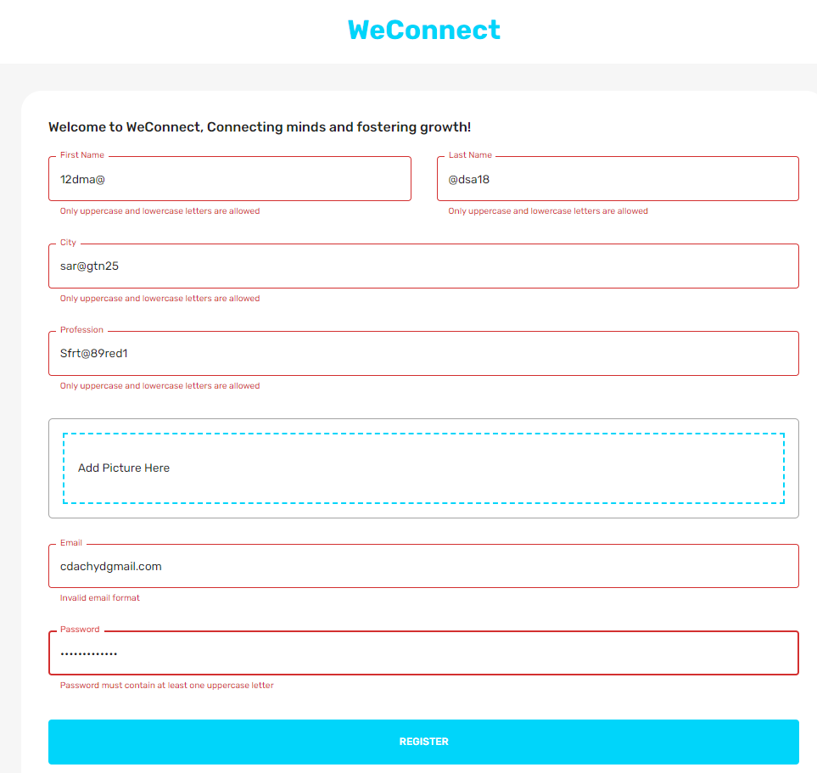
Authentication and Validation while Registering:

Slide 16
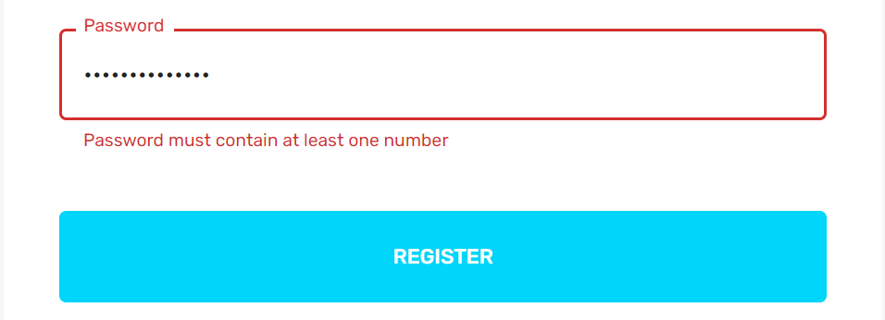
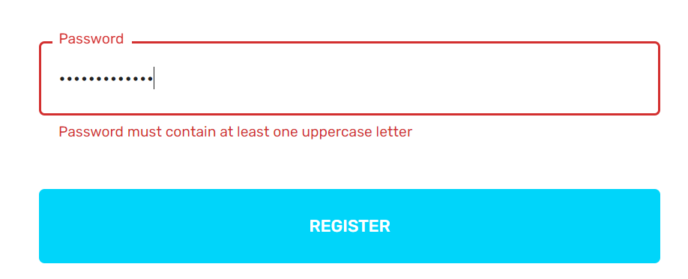
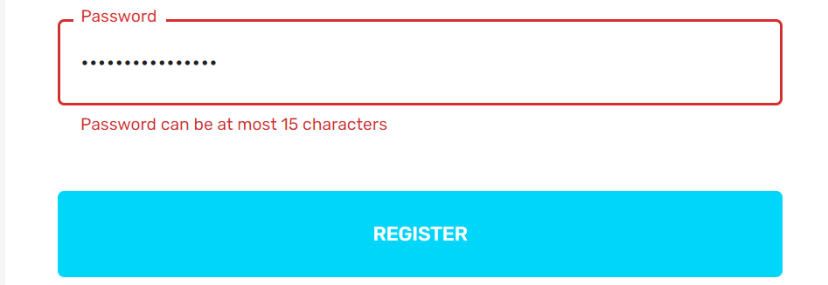
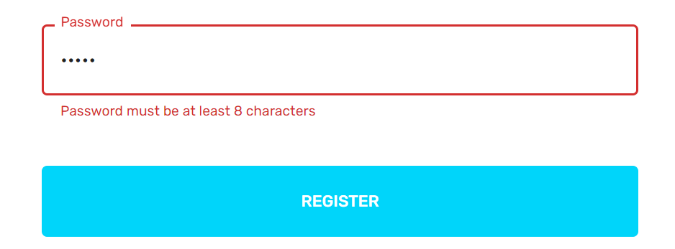
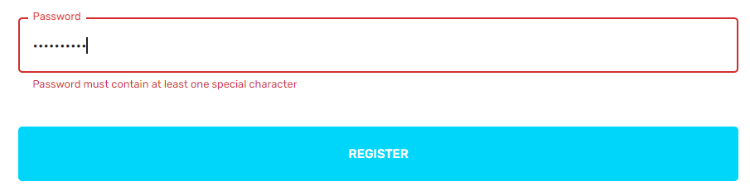
Password Validations :

Slide 17
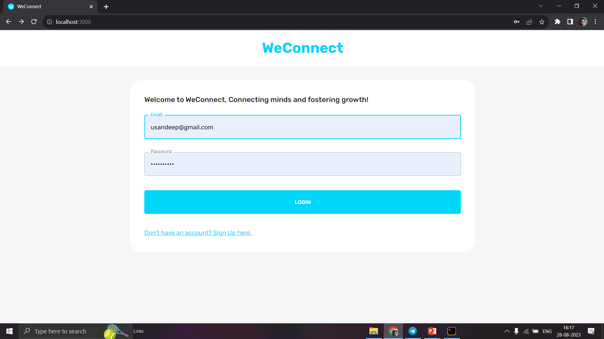
Login Page :

Slide 18
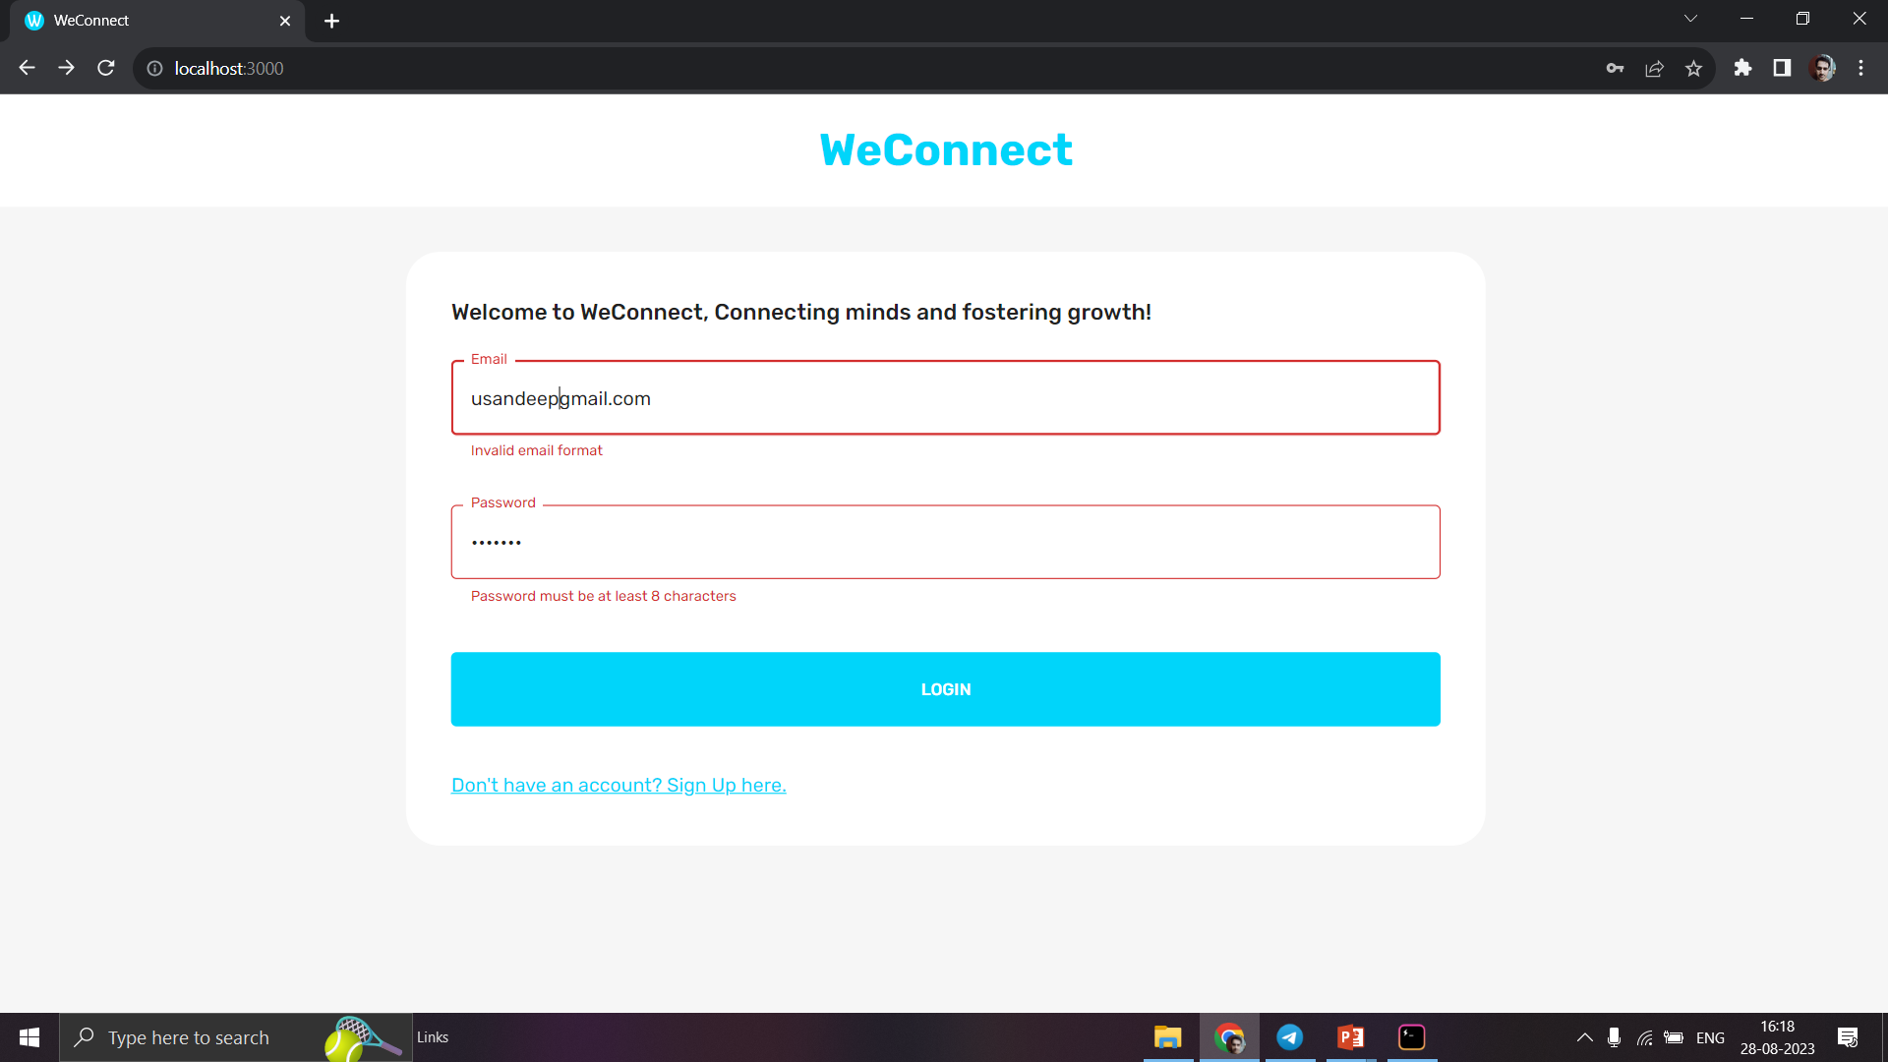
User Login Validation :

Slide 19
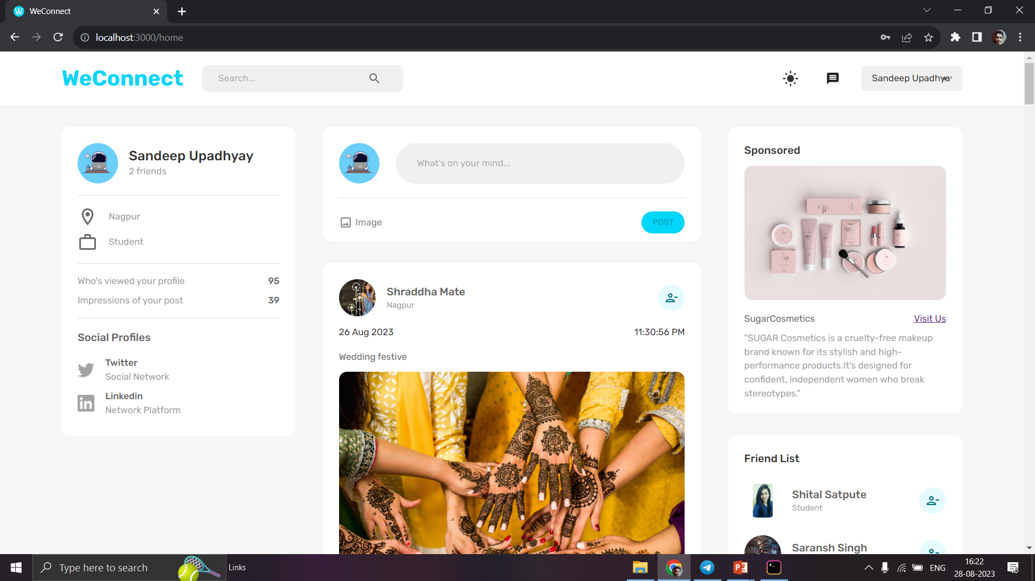
Home Page :

Slide 20
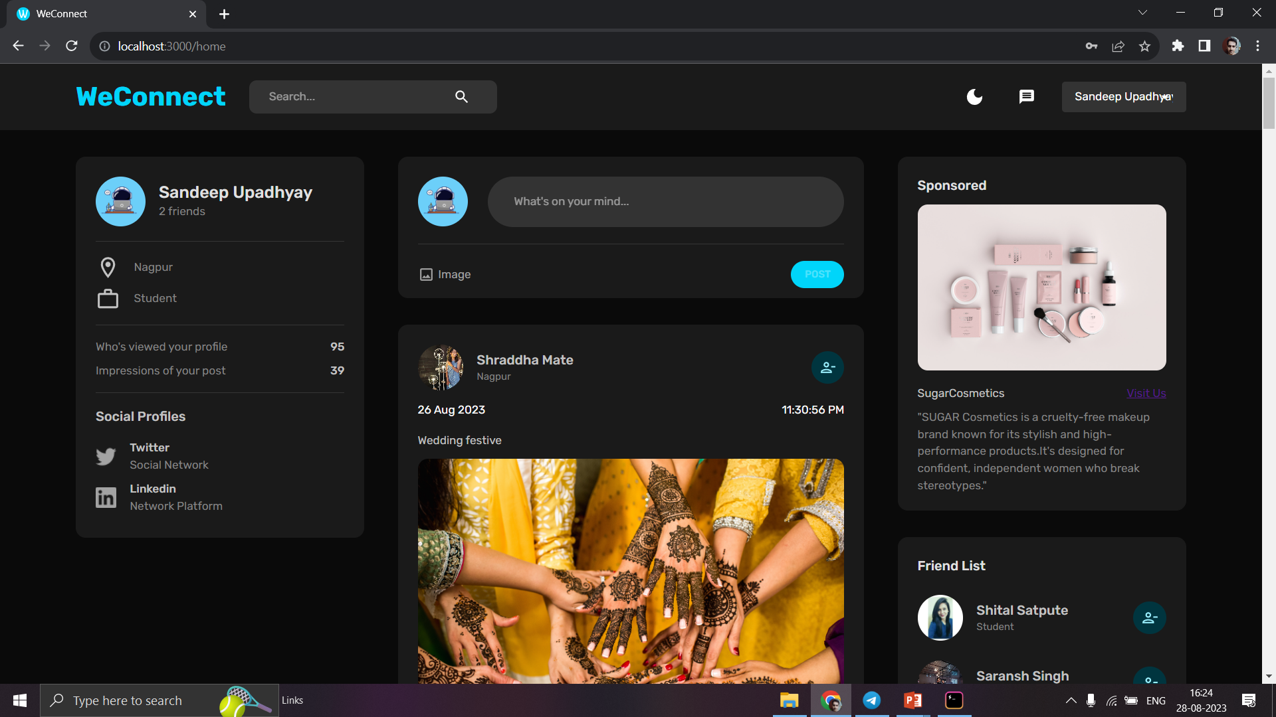
Dark Mode Feature :

Slide 21
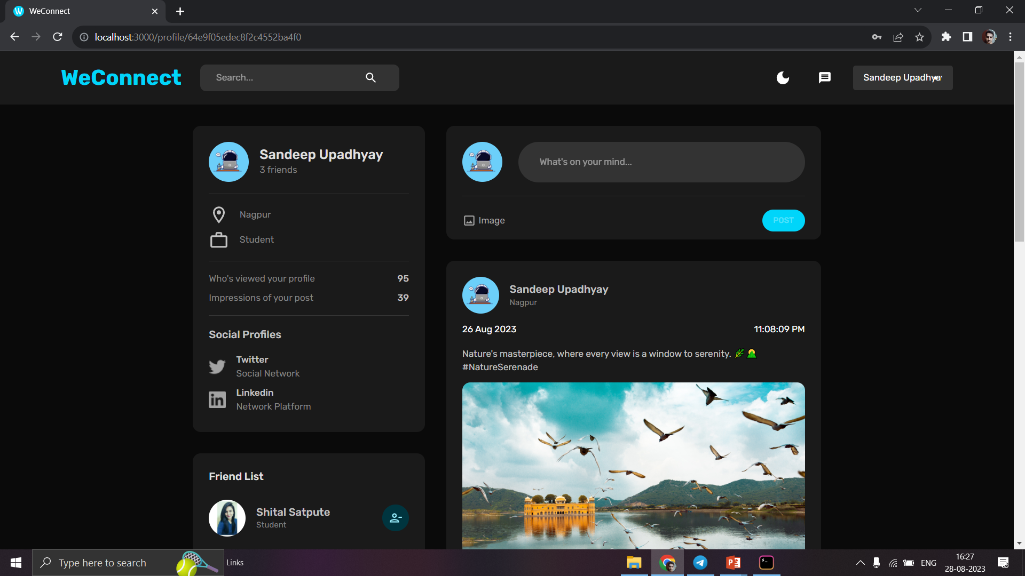
Profile Page :

Slide 22
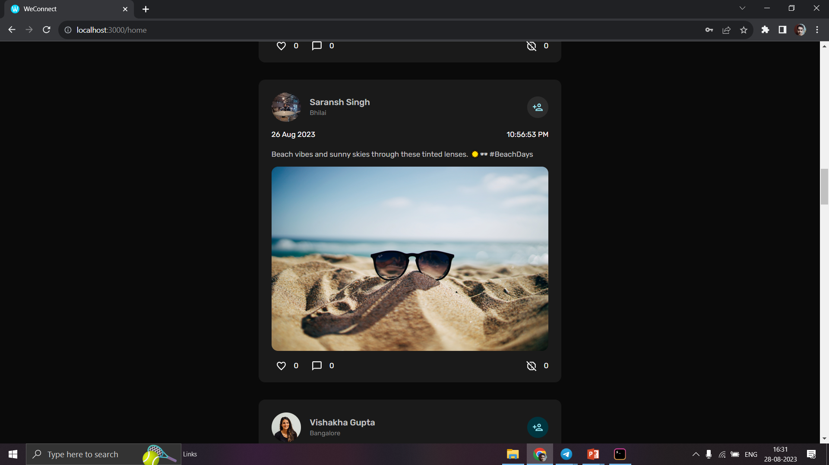
Adding Friend :

Slide 23
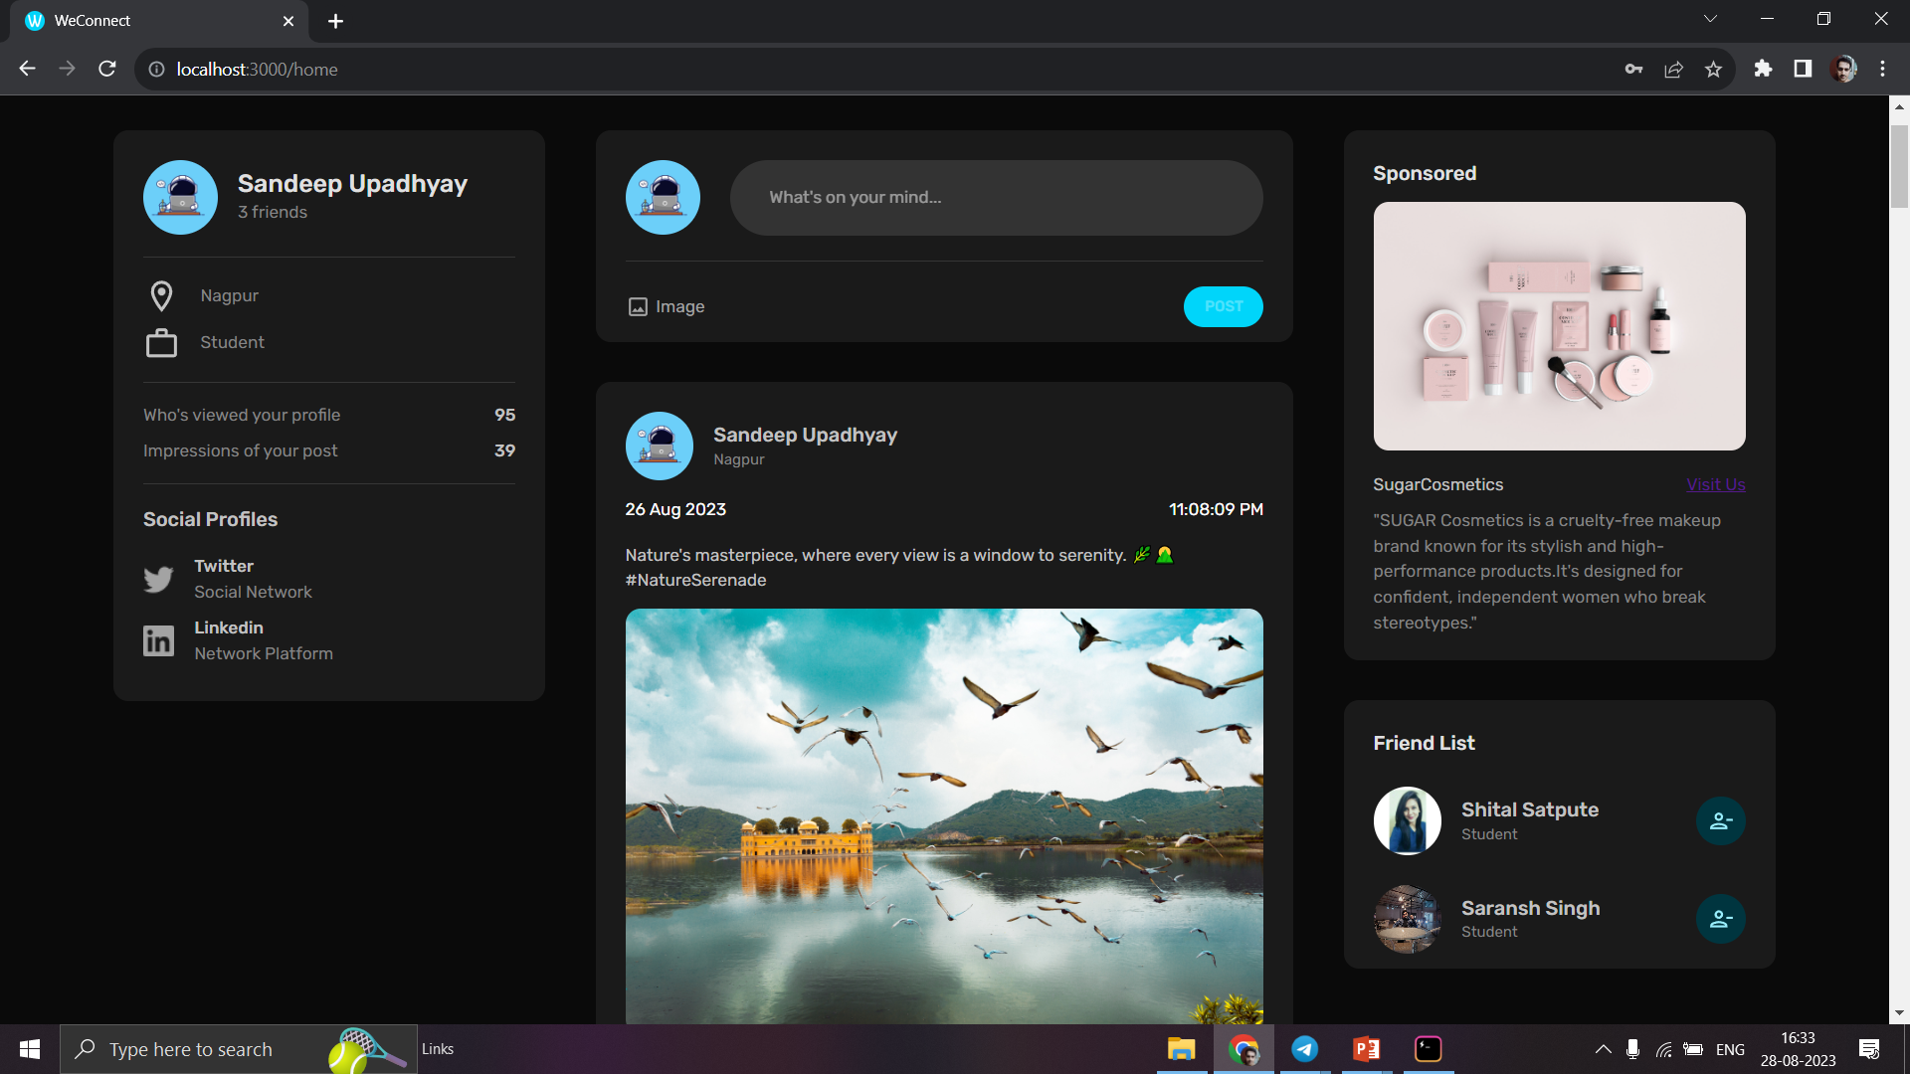
Removing Friend from Friend List:

Slide 24
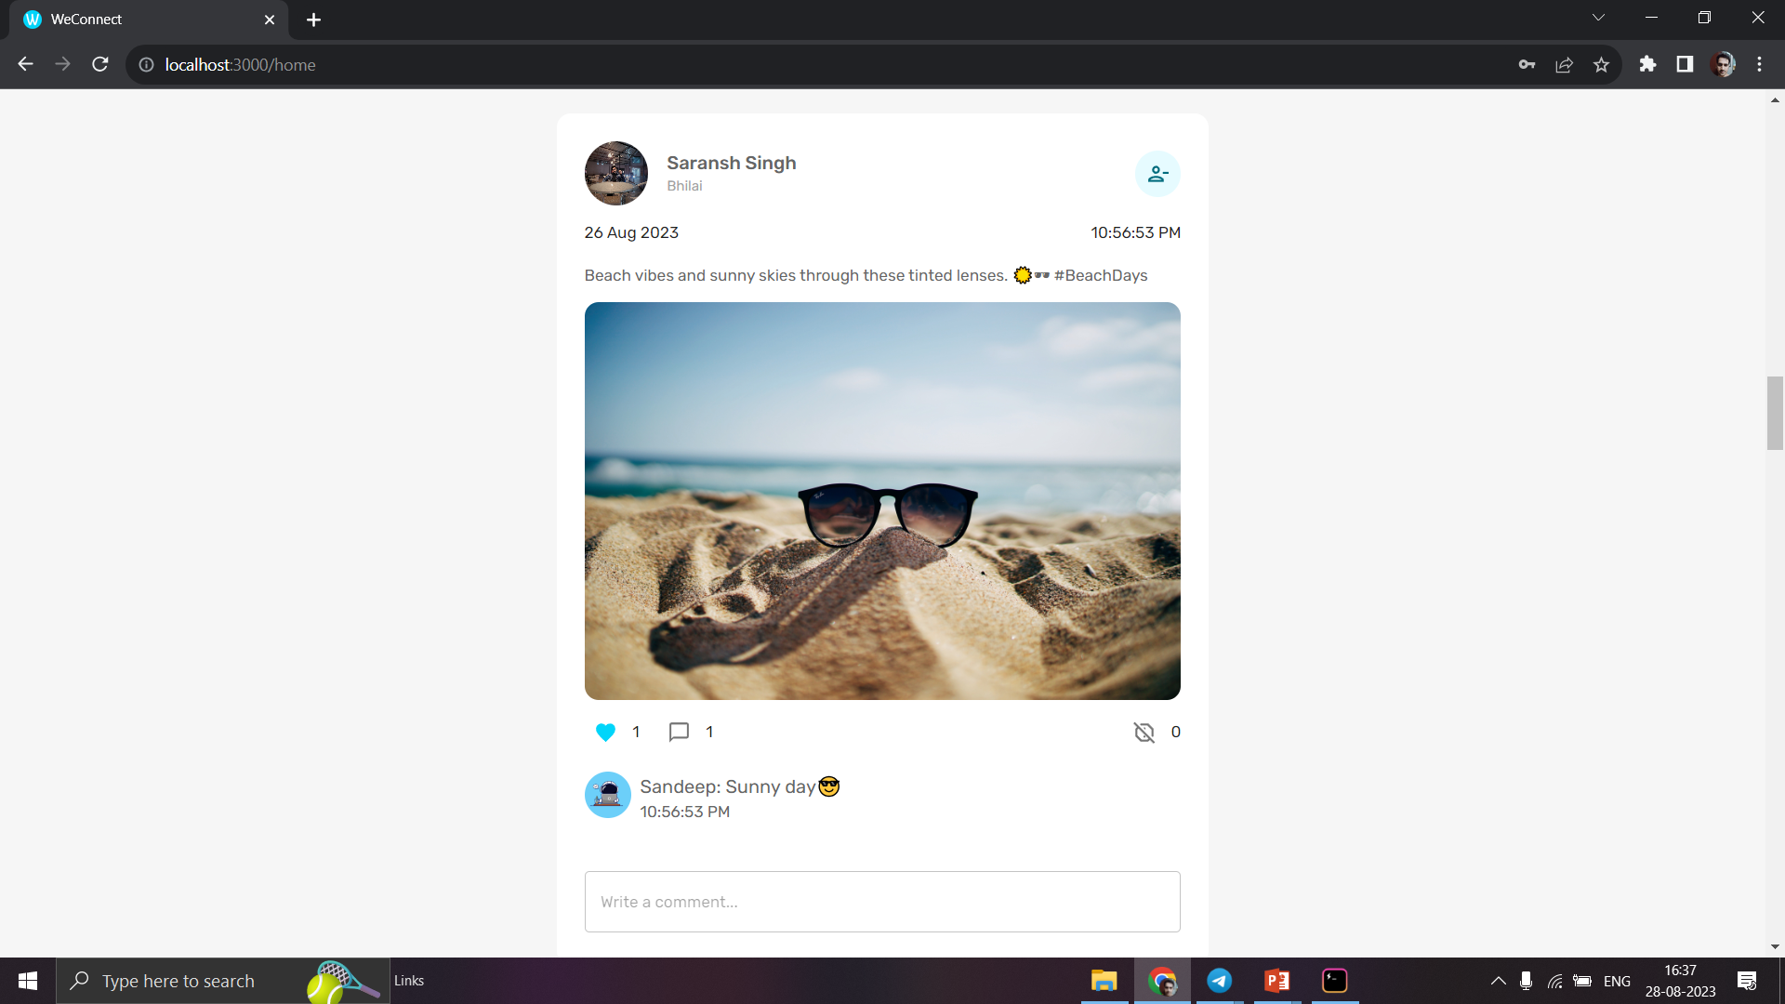
Like and Comment :

Slide 25
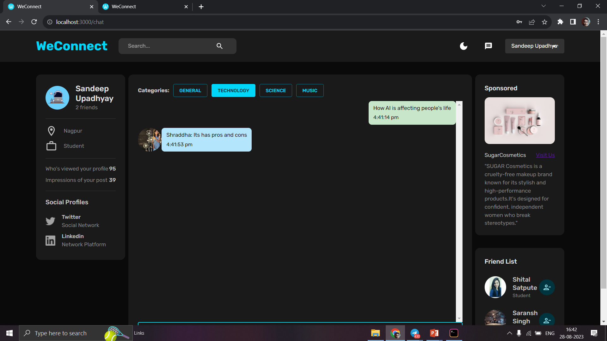
Chat Forum :

Slide 26
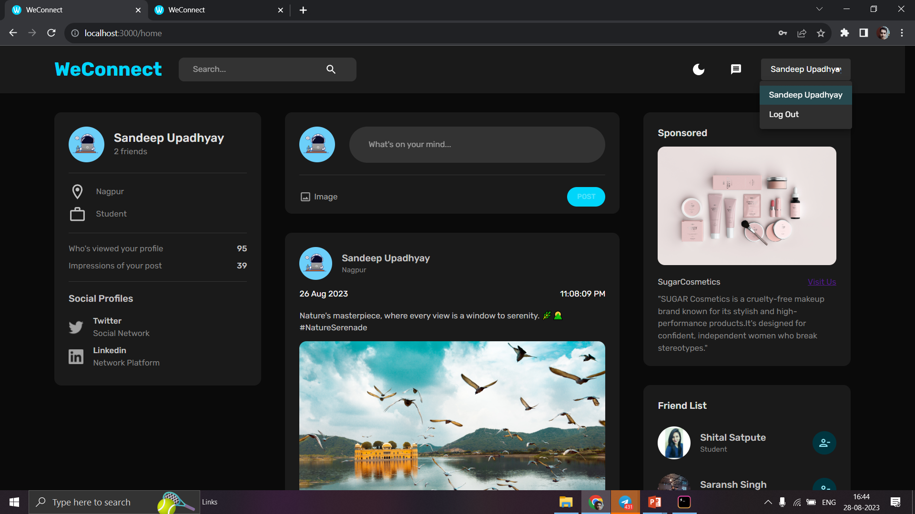
Log Out:

Slide 27
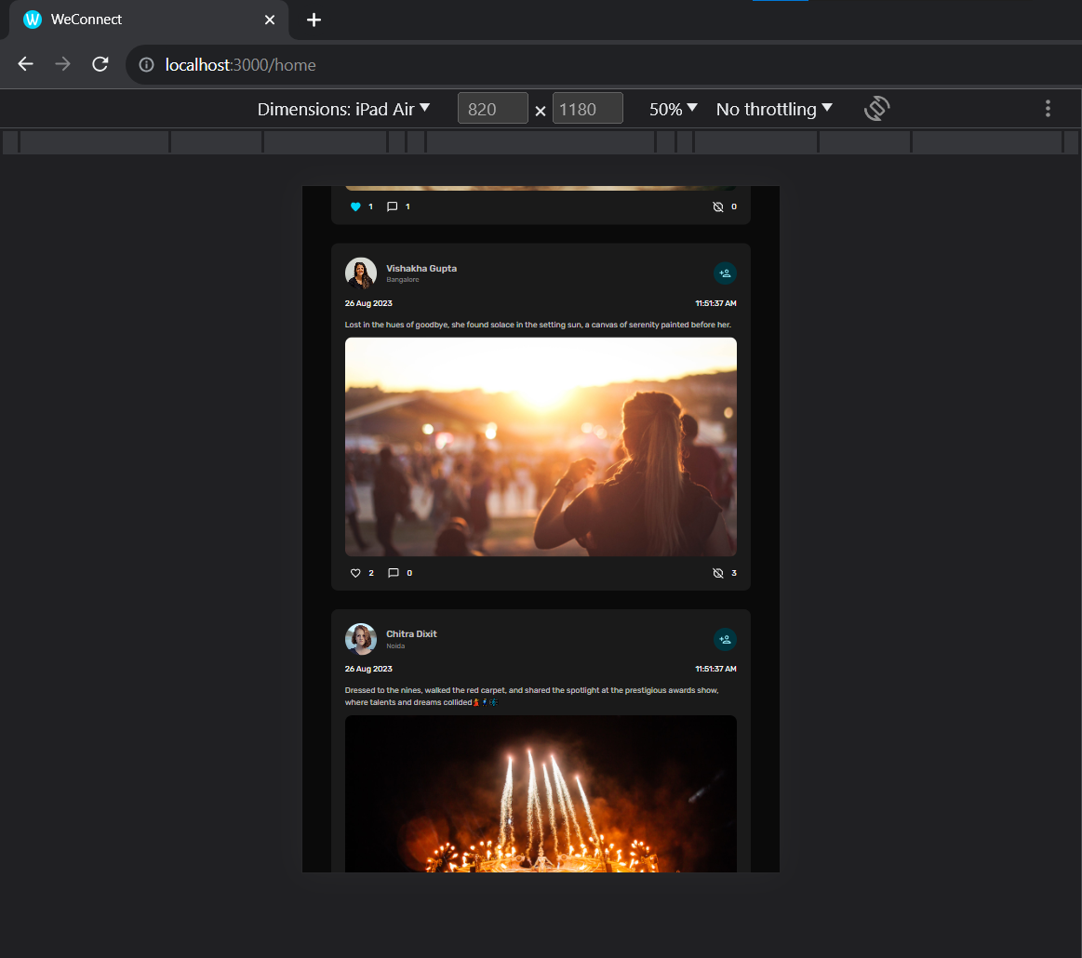
Responsive Feature :

Slide 28
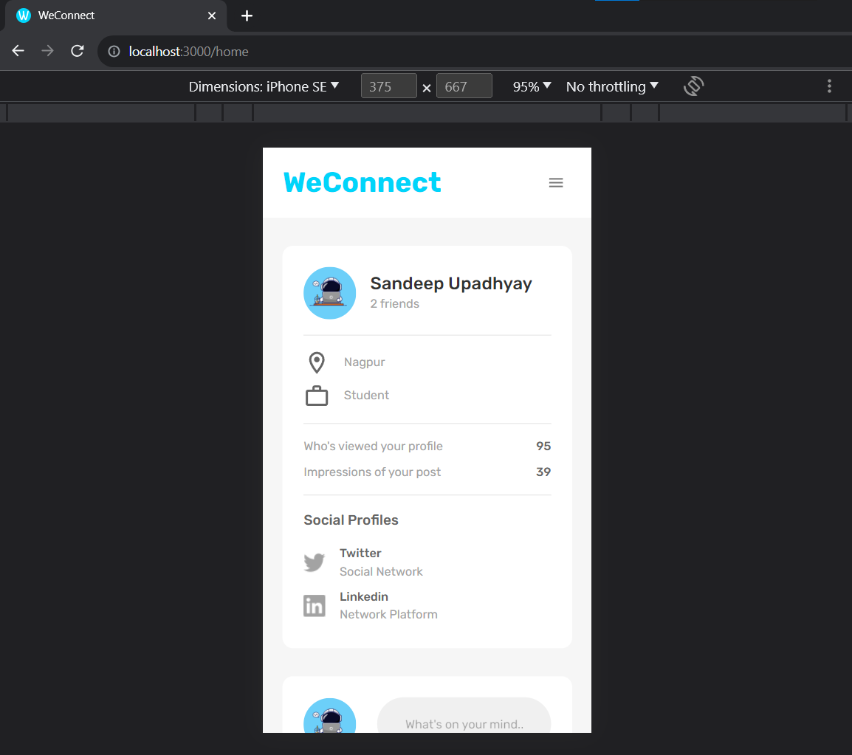
Responsive Website :

Slide 29
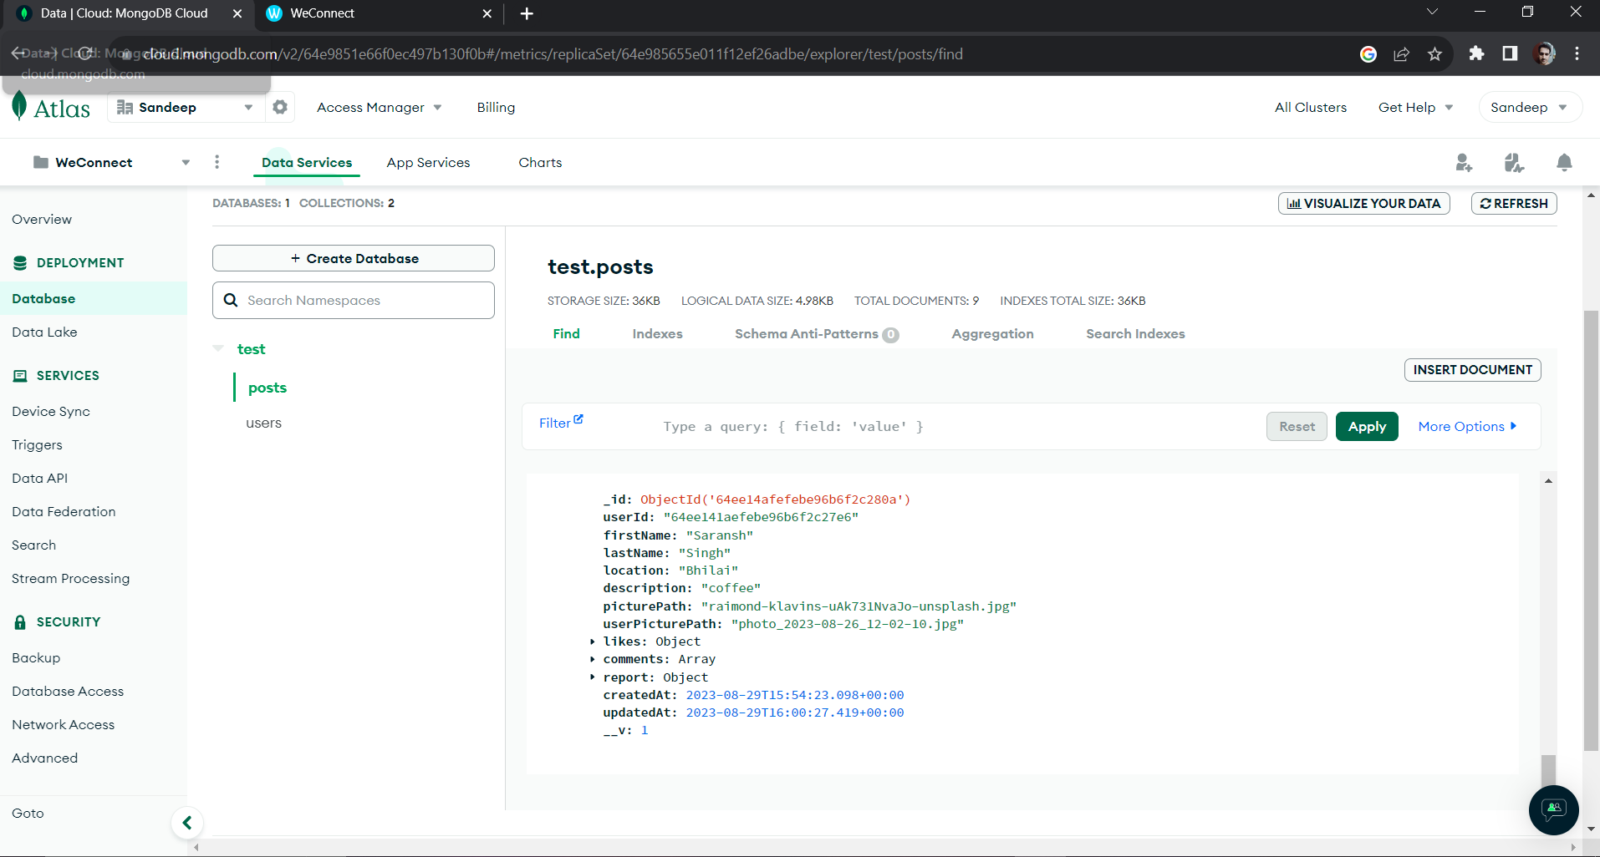
MongoDB Data

Slide 30
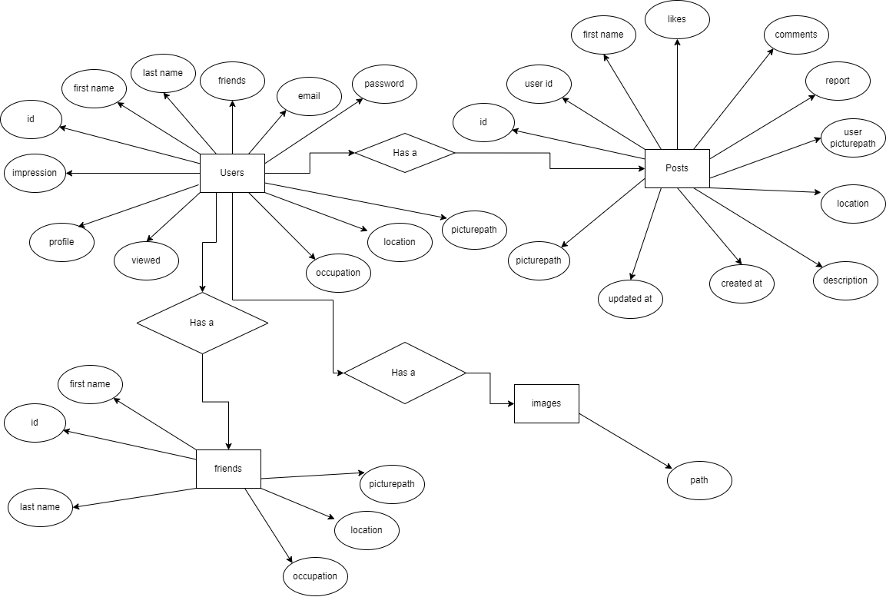
E-R Diagram :

Slide 31
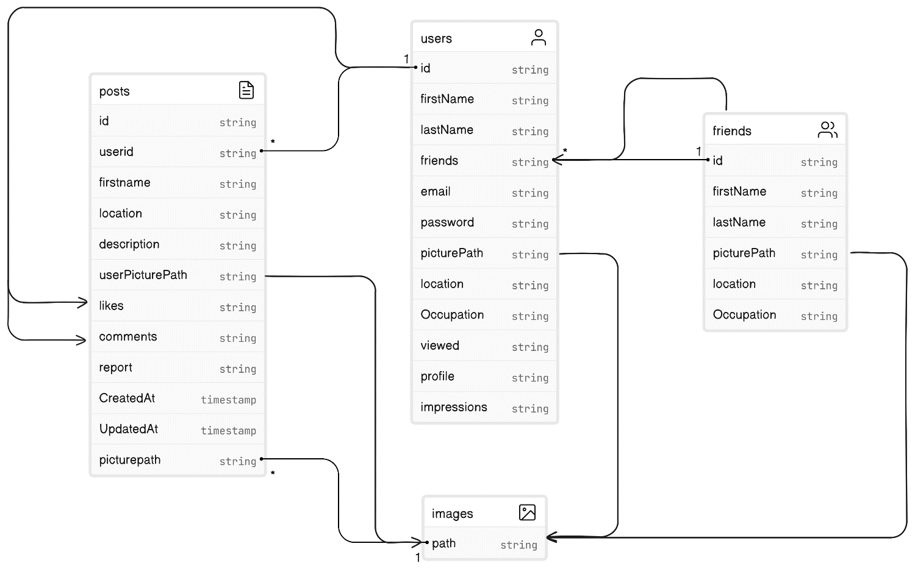
Class Diagram :

Slide 32
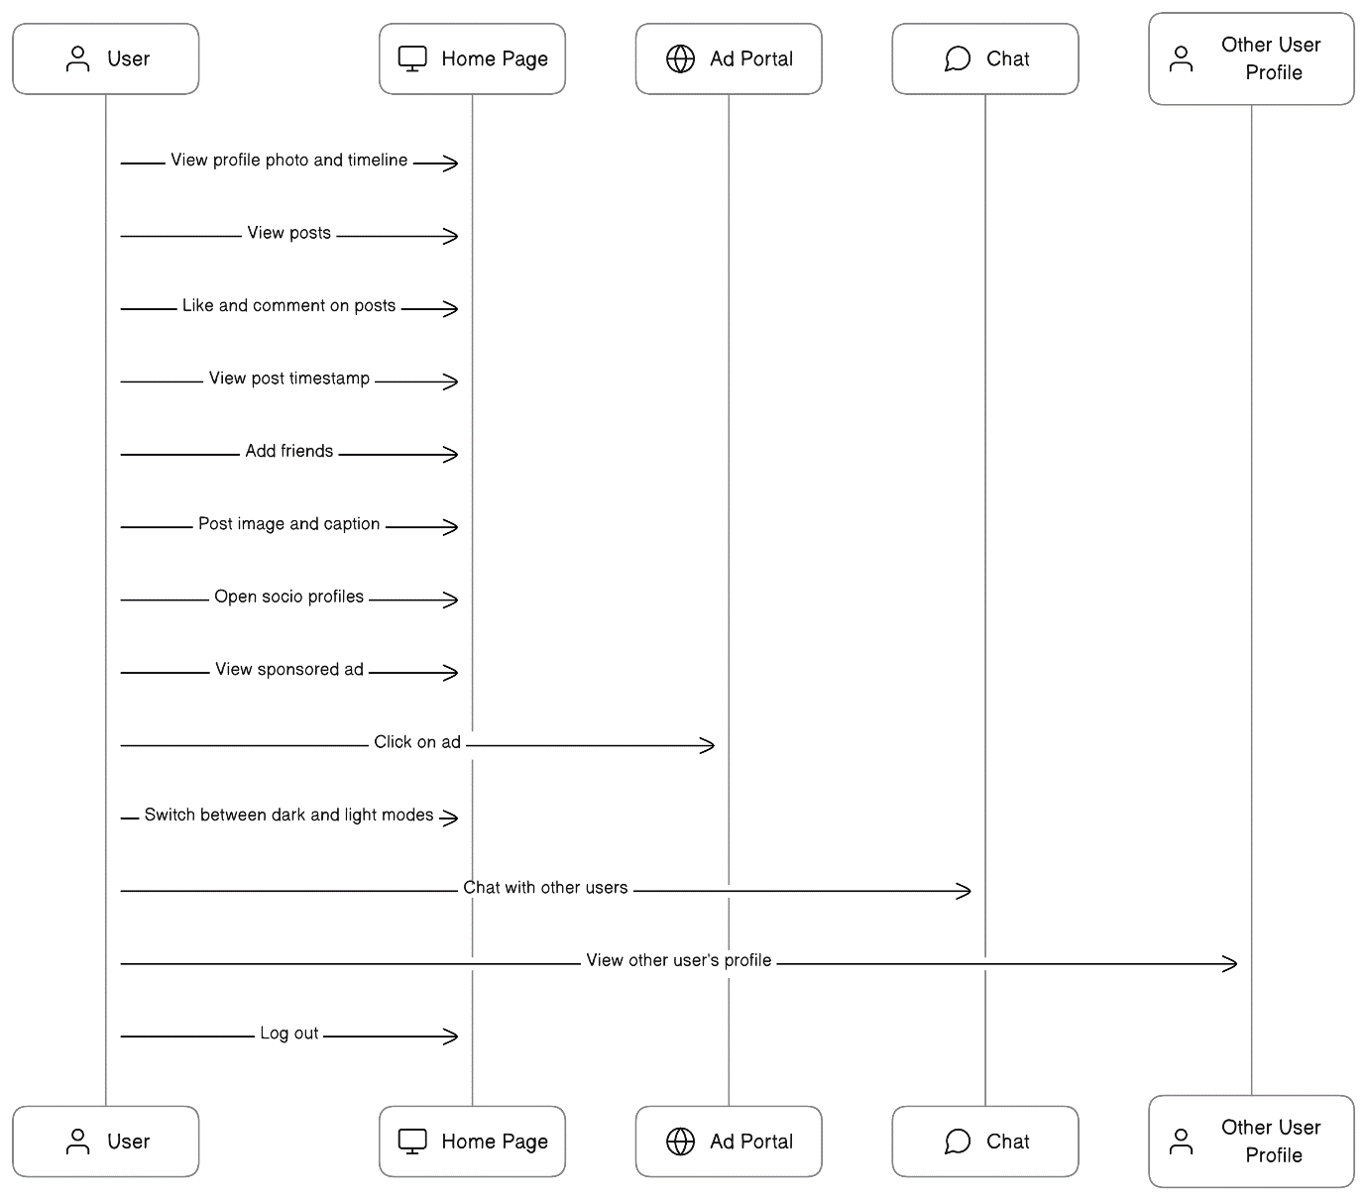
Sequence Diagram :

Slide 33
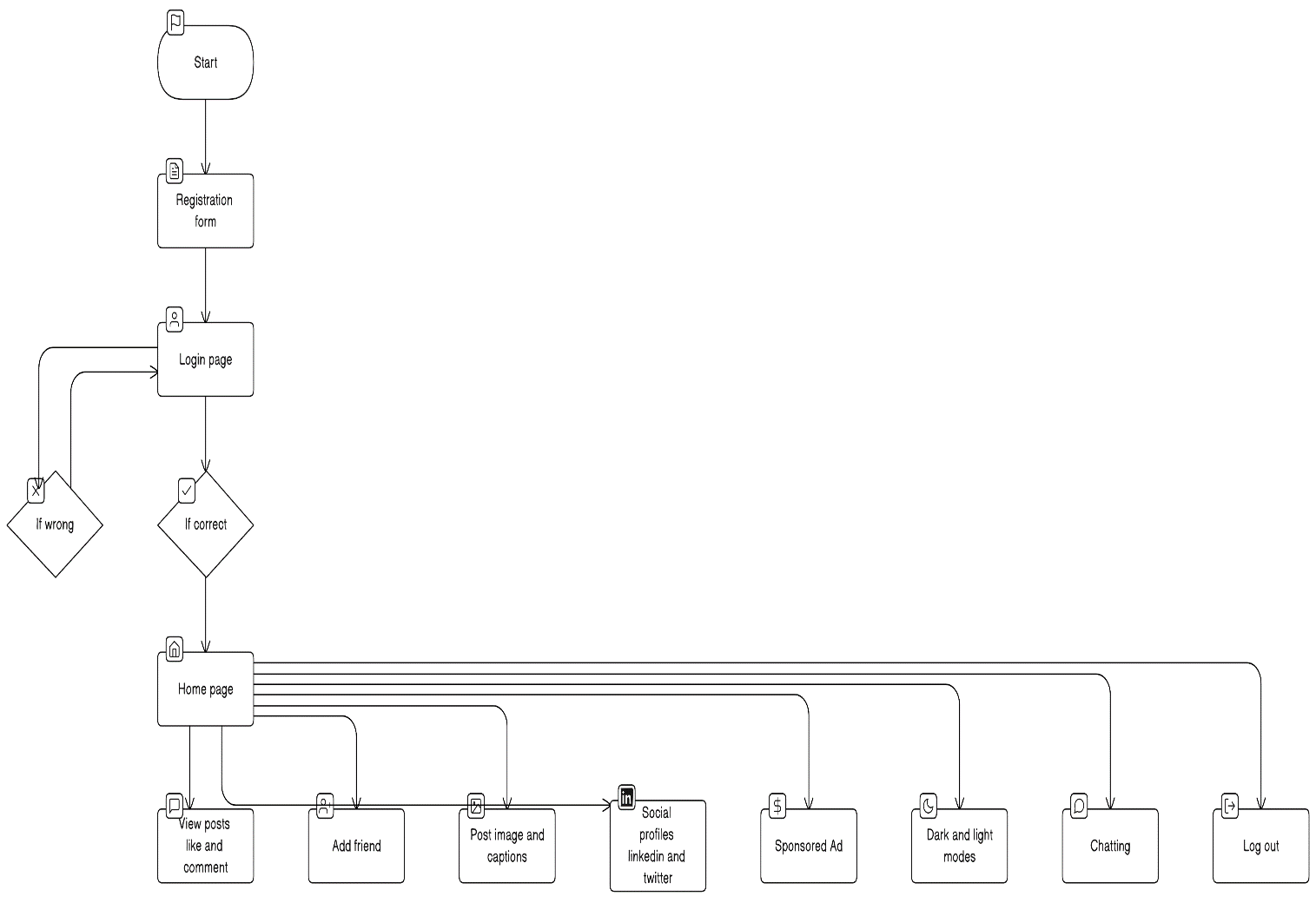
Data Flow Diagram :

Slide 34
FUTURE SCOPE
Enhanced Friend Search
Forum Chat Retention
Dynamic Profile picture update
Editable Post Updates

Slide 35
OUR TIMELINE
WEEK 3
WEEK 1
FINAL
VERSION
WEEK 2
WEEK 4
Backend and Database
Planning
Frontend
Progress review and Documentation

Slide 36
TEAM MEMBERS AND THEIR ROLES
FRONT-END
Shital Satpute
Registration and Login Page
Sandeep Upadhyay
&
Saransh Singh
Home Page , Profile Page , Chat Page
BACK-END AND DATABASE
Rutuja Khawashi
Rutuja Sawant
Sarang Topale

Slide 37
RESOURCES
Material UI: https://mui.com/material-ui/getting-s... Redux Toolkit: https://redux-toolkit.js.org/introduc...
React Router: https://reactrouter.com/en/v6.3.0/get...
Redux Persist: https://github.com/rt2zz/redux-persist
React Dropzone: https://react-dropzone.js.org/
Node: https://nodejs.org/en/download/
Nodemon: https://github.com/remy/nodemon
NPX: https://www.npmjs.com/package/npx
VsCode: https://code.visualstudio.com/download
MongoDB: https://www.mongodb.com/
Mongoose: https://github.com/Automattic/mongoose
JsonWebToken: https://github.com/auth0/node-jsonweb...
Multer: https://github.com/expressjs/multer
GridFS-Storage: https://github.com/devconcept/multer-...
Google Fonts: https://fonts.google.com/
Formik: https://formik.org/docs/overview
Yup: https://github.com/jquense/yup
Free Photos : https://unsplash.com/

Slide 38
SPECIAL THANKS TO OUR MENTOR MR. K VAMSIKRISHNA

